Slide 1
Analysis of hospital based ayurvedic clinical practice to gain real world data knowledge
Vinay Mahajan
Objective 1: Nature of data, arranging data for analysis
PhD thesis presentation
Guides: Ashwini Godbole, Girish Tillu, Ashwini Mathur
Notes:
Micro as well as macro level analysis is possible
Zoom in and zoom out
Possible usages:
1. Clinical Research
2. Pricing and Market Access
3. Pre-Approval Communication and Scientific Exchange
4. Promotional Interactions and Content
5. Fees for Service
6. Interactions with Patients and Patient Organizations
7. External training
The ADSL data useful for:
This has not been done since 2011 in the hospital as well as this kind of analysis has not taken place in Ayurvedic area.
Individual patient comprehensive view –
Covering all diseases reported as per visit
Corresponding medicines prescribed
Corresponding services prescribed
Covering complete In patient and Out patient information for the patient
Has been generated.
A subset of patients experiencing similar diseases is possible,
A subset of patients prescribed with a specific medicine is possible.
Complicated combinations of patients having certain diseases reported before and after certain diseases is possible.
Similar combinations of treatments
Patient ID is not present in each domain, but patient visit is used as the primary key [may be a suboptimal way to set-up the database]
RMSD patients visit the hospital premises more often than that of the metabolic patients.
More out patient visits compared to in patient visits.

Slide 2
Disclaimer
The following analysis should be seen from a learning point of view, a framework for Ayurvedic EHR analysis
This is a neutral view of the analysis – not a criticism of the practices at the hospital
This analysis is retrospective and should be used to improve the data standards, documentation practices
A humble attempt to build evidence base for ayurveda

Slide 3
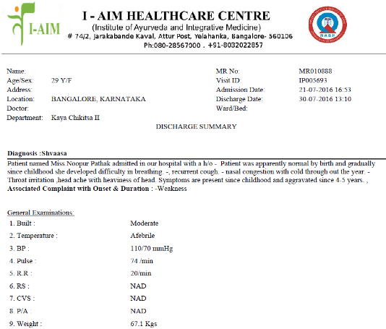
From a patient to ...
Operational insights
Clinical insights
New research ideas
Relationships between biomedical disease classification and ACD ..TRANS-DISCIPLINARY PERSPECTIVES

Slide 4
IAIM Hospital database Bengaluru
Reasonably large Ayurvedic electronic databases operational since 2010
Total number of patients treated = ~50,000
Out patients = ~45,000
In patients = ~7,000 (* some patients are both Out patient / in patient)
~1,70,000 out patient visits
Patients from more than 50 countries
More than 900 disease conditions treated, > 3000 medicines recorded
Implementation of Ayurvedic Clinical Dictionary for diagnosis
Data as of June 2018

Slide 5
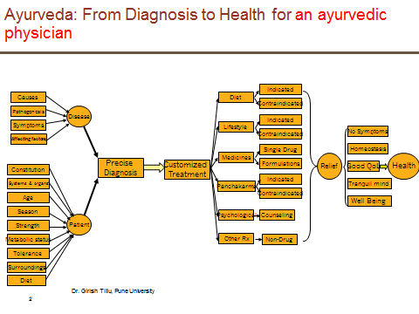
Theoretical flowchart based on texts

Slide 6
Pilot study based on I-AIM data
A few facts: Duration: 1st January 2011 to 5th June 2015
Total registered patients 31,826
14,188 (49.5%) patients only 1 visit data
~ 1290 (4.5%) patients with more than 10 visits
Based on Excel, only textual representation
Major disease areas treated: musculoskeletal and metabolic diseases
Total 2,29,011 therapies were administered to 8,364 patients
Out of 58,596 patient visits, details of 53,332 visits (91%) are documented as diagnostic codes of Ayurvedic Classification of Diseases (ACD)
Perhaps the largest electronically available ayurvedic treatment database.
Ref: Information based on analysis done by Girish Tillu – A snapshot of clinical records

Slide 7
New role requirement: statistical programmer
Hospital administration
Patients
Clinicians / Doctors
Nurses
Pathology reports
Pharmacists
Legal and regulatory needs
Data usage
Data usage
Regulatory bodies
Ayurvedic researchers
Insurance companies
Policy makers
Statisticians
Research scientists
Data generators

Slide 8
Statistical programming
Statistical programmers play a key role in
turning the data from clinical trials into knowledge and
supporting the development of new medicines.
Statistical programmer
Converts raw data to analyzable data
Performs data checks
Creates Tables, Listings, Figures (visualizations)
Customizes the data to produce an output which displays the behavior of the data
Inference of the data is done on the TFLs
Not an IT person
Not just a statistician
Not a data manager (cleaning the data)
Not a database developer to store the data
Uses IT systems
Uses statistician’s mind
Provides insights into building database
Scientific rigor
Uses multiple technologies
Uses ideas to convert
An observation to summaries to Stories
Clinical insights w/o being a doctor
Pioneering effort and new contributions: as this kind of work was never done in ayurvedic area

Slide 9
Statistical programming could contribute in the following areas:
Clinical operations:
Operational efficiencies
R&D:
Automated documentation for regulatory / audit needs
Clinical decision support
Reproducible research
Public health:
Patterns of diseases and medicines
Disease surveillance
Population health management
Data to actionable information
Evidence based medicine:
Empirical evidence
Nature and context of disease
Analysis of clinical practice data
New needs:
New needs never thought of in ayurvedic area so far*
Much more than excel subsets / pivot tables ...
Advanced computing
Advanced visualizations -- A picture is worth a thousand words
Pioneering effort and new contributions: as this kind of work was never done in ayurvedic area
*: our assumption, as no one has seen anything like this before within ayurverda

Slide 10
Questions
Hospital management | Regulatory / insurance | Teaching / PhD / MD
Number of patients Patient characteristics % of males / females The age groups Countries, states, cities Number of visits Visit patterns Number of In / Out Patients Assessments done at visit Overall duration of visits Reported diseases Number of diseases Operational insights Pharmacy | Evidence base generation (EBM): integration of best research evidence with clinical expertise, patient and parents’ preferences Use these data as "secondary use“ Labels of medicines and prescriptions in the database match each other Metal based treatments and related discussions Initiation of “Ayurvedic registry” Cost per visit | Data as a supplementary material for PhD / MD Data: as an additional teaching material for college students Rare disease identification Cohort generation: Understand the natural history What is the meaning of cohort in ayurvedic area? Predict any questions, trajectory of diseases, etc. Predicting the next complication or next disease, when and what? Quantifying the effect of intervention Construct evidence based guidelines

Slide 11
Questions
Hospital doctors | Publications / Research proposals | General public / popular articles
Individual patient data and how are the treatments prescribed Diseases differences in gender, season, age group Disease – disease combination Higher / lower diseases and natural occurrences Prescription of treatments | Data backed proposals for research grants Case report / series generation for publication Validation of Ayurvedic treatment protocols In absence of “hard clinical end point” short term outcomes (intent adherence to the treatment) intermediate term outcomes (actual adhere) long term outcomes (overall health) Longitudinal / epidemiologic view Pre and post analysis Co-morbidity analysis | Weekly communications in local / national papers Simple short stories to build image of Ayurveda Based on the seasonal diseases, provide simple preventive measures

Slide 12
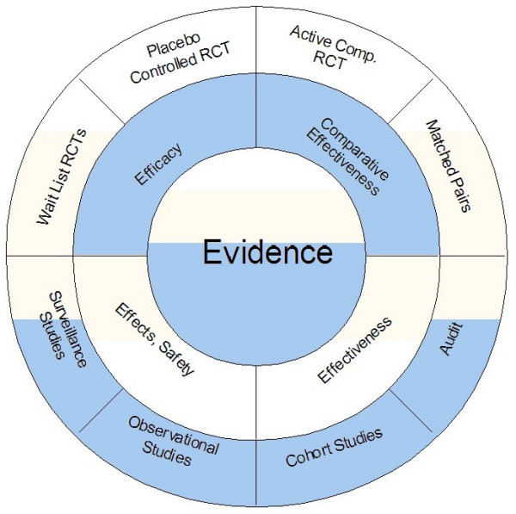
Evidence: Proposed
Approach
Clinical practice data analysis
Walach H et al. BMC Med Res Methodol. 2006, 6:29

Slide 13




Data observations into summaries, stories

Slide 14
Data collection tables in the source database (150+ tables)
action_rights | diet_prescribed | hospital_technical | package_componentdetail | patient_registration | section_field_options | store_item_batch_details | test_details
admission | discharge_format_detail | icu_bed_charges | package_item_charges | patient_section_details | service_consumable_usage | store_item_details | test_org_details
anesthesia_type_charges | doctor_charges_backup | ip_bed_details | package_prescribed | patient_section_details_orig | service_documents | store_item_lot_details | test_results_master
area_master | doctor_charges_op_backup | ip_prescription | patient_activities | patient_section_forms | service_master_charges | store_patient_indent_details | test_visit_report_signatures
bed_details | doctor_consultation | item_supplier_prefer_supplier | patient_consultation_field_values | patient_section_image_details | service_master_charges_backup | store_patient_indent_main | test_visit_reports
bill | doctor_consultation_charge | manf_master | patient_demographics_mod | patient_section_values | service_org_details | store_po | tests_conducted
bill_activity_charge | doctor_medicine_favourites | medicine_dosage_master | patient_deposits | patient_service_prescriptions | services | store_po_main | tests_prescribed
bill_adjustment | doctor_op_consultation_charge | medicine_id_health_authority_unique | patient_deposits_setoff_adjustments | patient_test_prescriptions | services_prescribed | store_reagent_usage_details | theatre_charges
bill_charge | doctor_org_details | message_recipient | patient_details | ppfv_form_detail_id | stk_chkpt | store_reagent_usage_main | u_user
bill_charge_adjustment | dyna_package_category_limits | mrd_casefile_attributes | patient_details_patient_phone_country_code | preauth_prescription | stock_issue_details | store_reorder_levels | url_action_rights
bill_receipts | dyna_package_charges | mrd_codes_doctor_master | patient_discharge | preauth_prescription_activities | stock_issue_main | store_retail_customers | user_services_depts.
complaintslog | dyna_package_org_details | mrd_codes_master | patient_documents | prescribed_medicines_master | store_adj_details | store_sales_details | visit_vitals
consultation_charges | equipement_charges | mrd_diagnosis | patient_general_docs | progress_notes | store_adj_main | store_sales_main | vital_reading
consultation_org_details | estimate_bill | mrd_observations | patient_hvf_doc_values | registration_charges | store_checkpoint_details | store_stock_details
deposit_setoff_total | estimate_charge | operation_charges | patient_medicine_prescriptions | sample_collection | store_estimate_details | store_transaction_lot_details
diagnostic_charges | favourite_reports | operation_org_details | patient_other_medicine_prescriptions | sch_resource_availability | store_grn_details | store_transfer_details
diagnostic_charges_backup | fixed_asset_master | other_services_prescribed | patient_other_prescriptions | sch_resource_availability_details | store_grn_main | store_transfer_main
diagnostic_reagent_usage | follow_up_details | outsource_sample_details | patient_packages | scheduler_appointment_items | store_indent_details | supp_inv_id
diagnostics | growth_chart_reference_data | pack_org_details | patient_pdf_form_doc_values | scheduler_appointments | store_indent_main | supplier_master
diet_charges | ha_item_code_type | package_charges | patient_prescription | screen_rights | store_invoice | temp_stock_item_batch_with_diff_mrp_expdt

Slide 15
Data observations into summaries, stories
Generic algorithm and steps followed
Use R program to generate tabular or graphical analysis
Use source tables from the SQLserver
Use SQL queries to combine necessary tables
Use R program to create analysis data tables
200+ tables in SQL
25+ tables used for calculations
13 tables converted
6 tables “staging tables”
1 reference dataset: ~65 variables
50 Steps from start to end
Use Tableau to generate interactive visual analysis
8 tables converted to
95+ CRF pages and 515 variables
25 Steps from start to end
Login on the SQL server using the credentials
Use the IAIM schema, access following tables to generate base table with
Demographics information, Patient Visit information and prescribed treatments
STATE_MASTERa
COUNTRY_MASTER
CITY
STATE
PATIENT_DETAILS
PATIENT_REGISTRATION
MRD_DIAGNOSIS
PATIENT_PRESCRIPTION
PATIENT_MEDICINE_PRESCRIPTIONS
IP_PRESCRIPTION
SERVICES_PRESCRIBED
SERVICES
MEDICINE_SALES_VIEW
There are many CRF pages built to collect relevant Ayurvedic data, measurement data, Hospital visit data, food / exercise advice, etc.
This data is present in the following tables:
PATIENT_SECTION_DETAILS
PATIENT_SECTION_VALUES
SECTION_MASTER
SECTION_FIELD_OPTIONS
SECTION_FIELD_DESC
PATIENT_CONSULTATION_FIELD_VALUES
The datasets created in steps 2 and 3 are further processed using R programming language and the analysis ready datasets are created

Slide 16
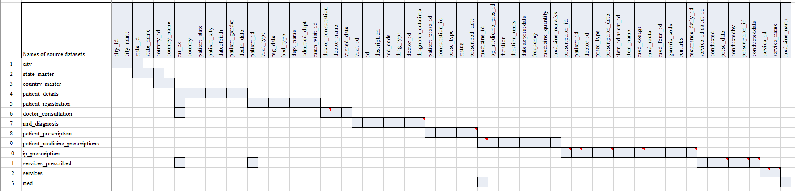
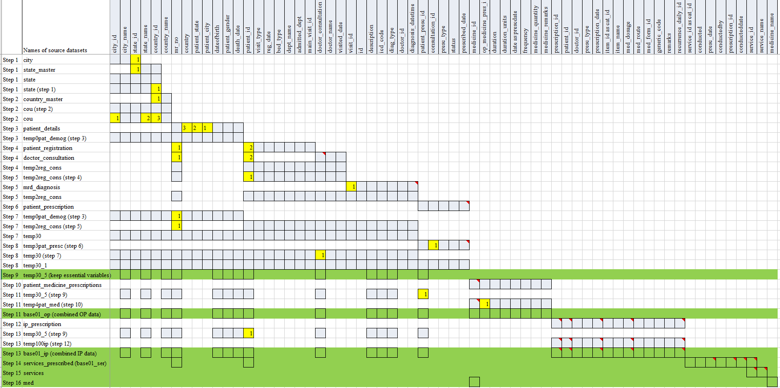
Flow of steps

Slide 17
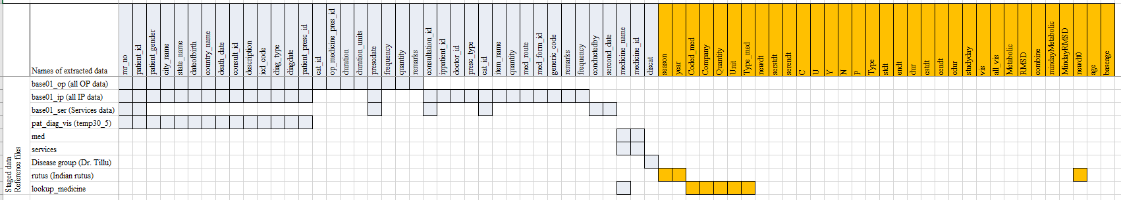
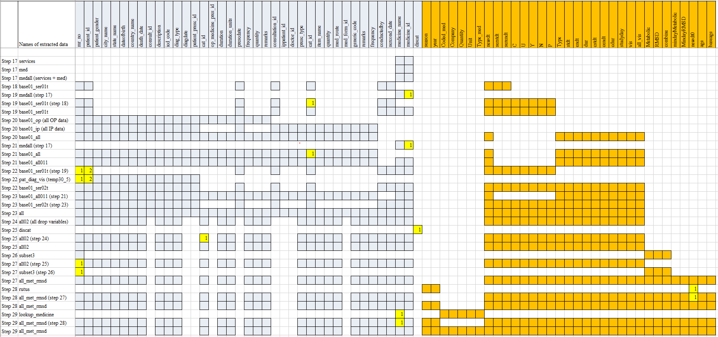
Flow of steps

Slide 18
Versions of data used in the analysis
Data version | Version 1 | Version 2 | Version 3
Date time frame | From start of the hospital to Oct 2016 | From start of the hospital to Oct 2017 | PDF file version of data for 15 In Patients
Data domains | Lab Vital signs Diagnosis | All the available data in the hospital database | Specific patient visits case report forms

Slide 19
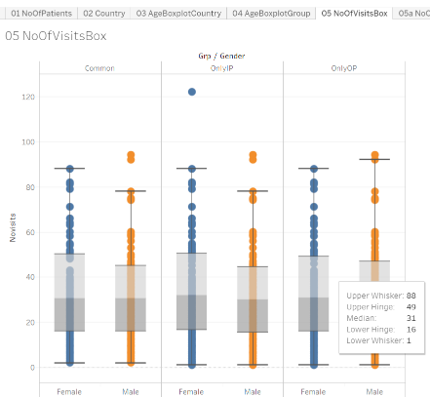
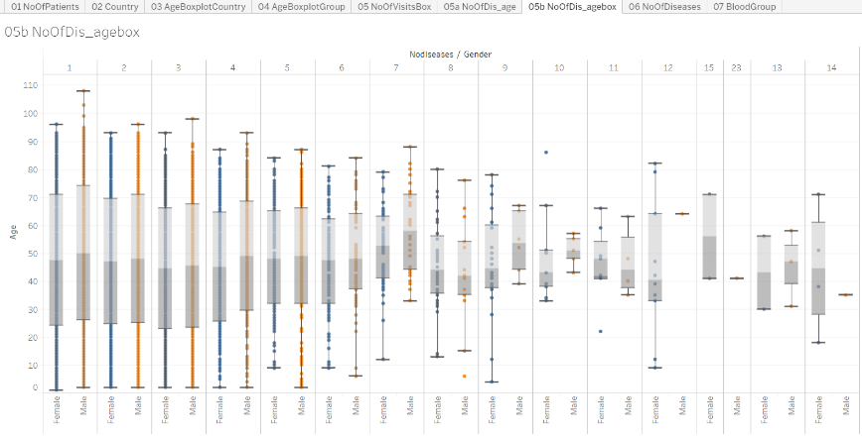
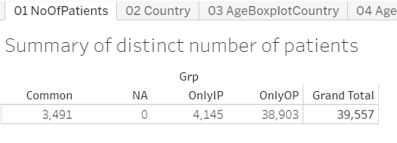
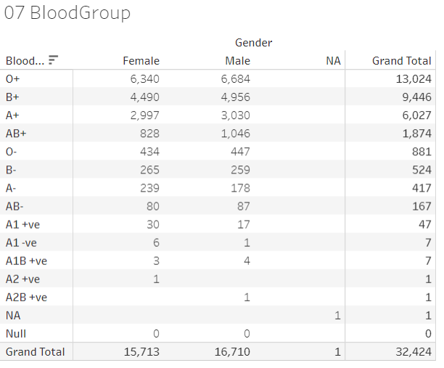
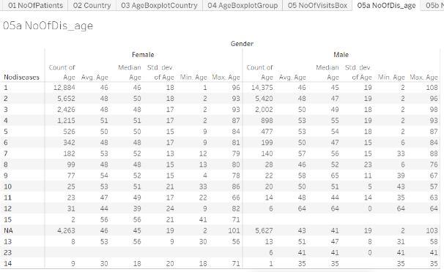
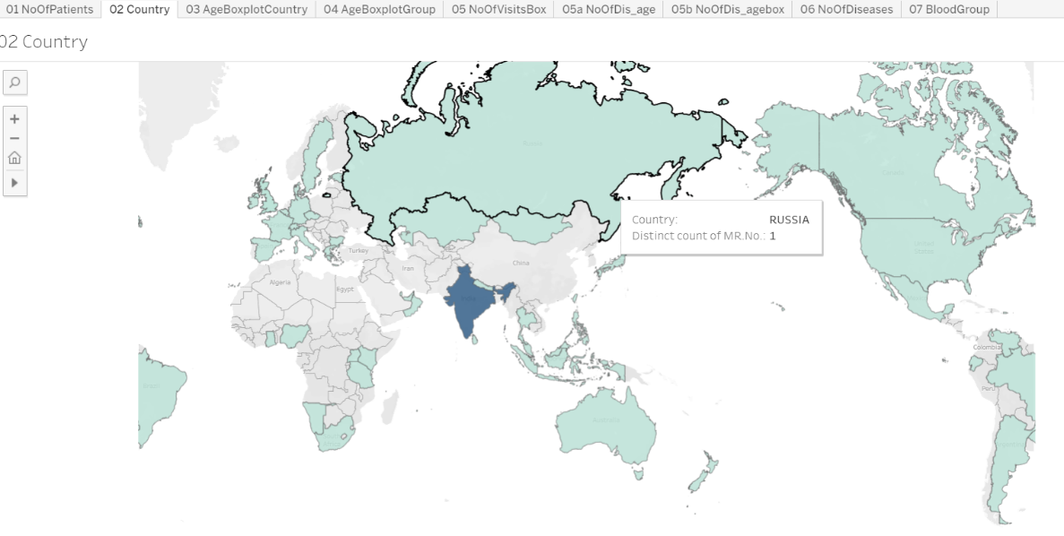
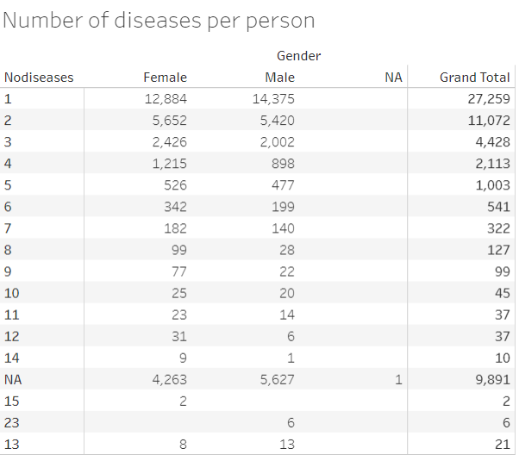
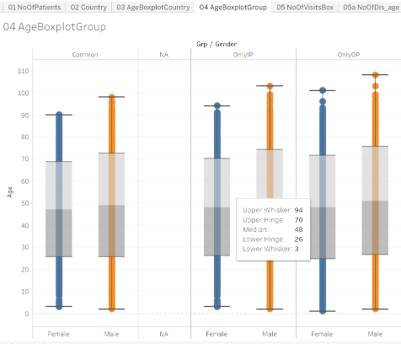
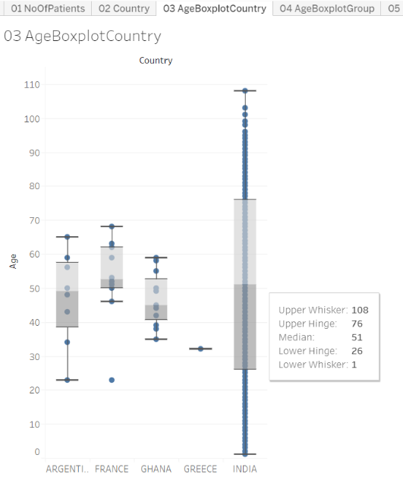
Hospital status
From start of the hospital to Oct 2016
Summary of distinct number of patients
02 Country
03 AgeBoxplotCountry
04 AgeBoxplotGroup
05 NoOfVisitsBox
05a NoOfDis_age
05b NoOfDis_agebox
Number of diseases per person
07 BloodGroup
https://public.tableau.com/views/04_patient_analysis_tablaeu/05bNoOfDis_agebox?:display_count=y&:origin=viz_share_link

Slide 20
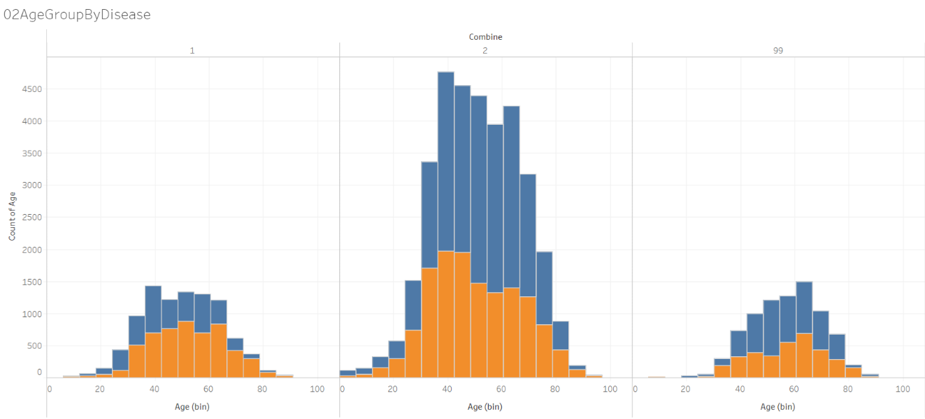
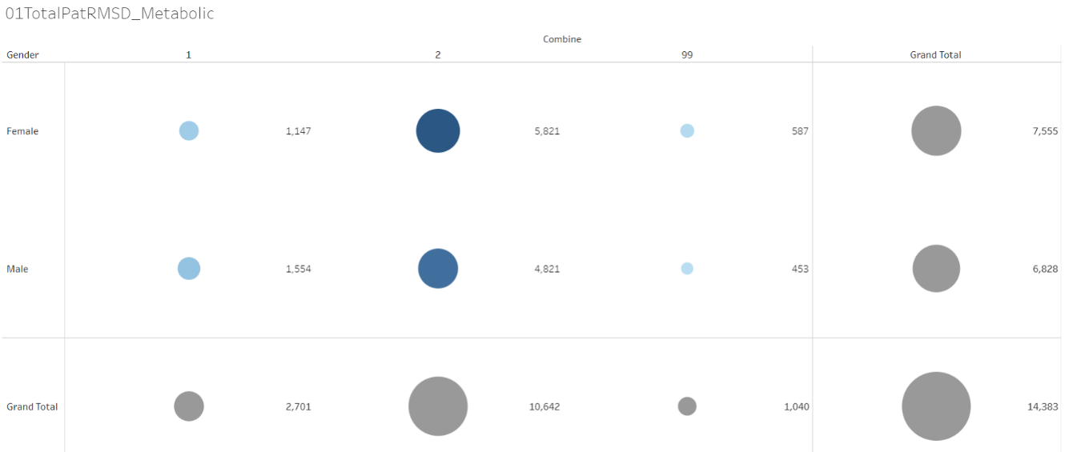
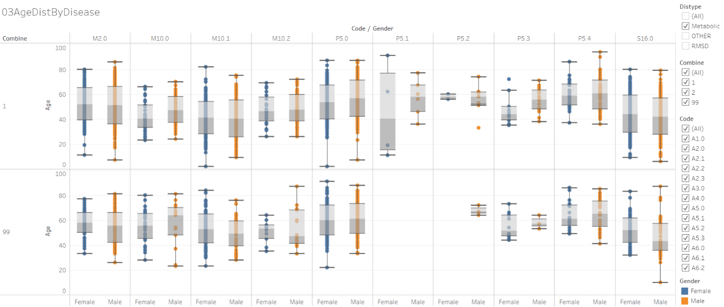
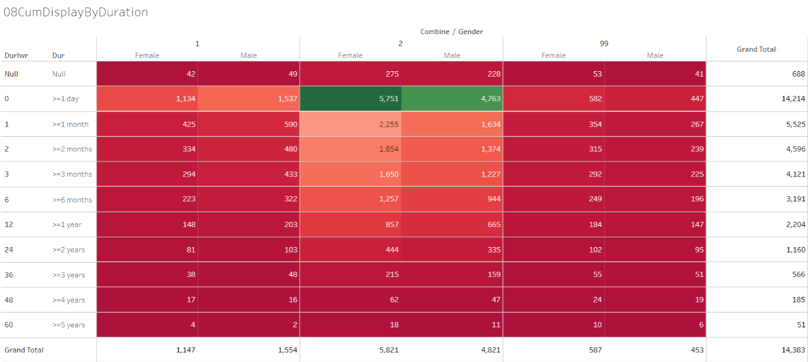
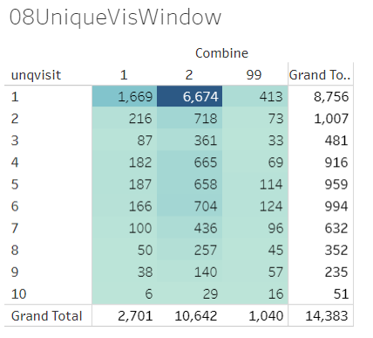
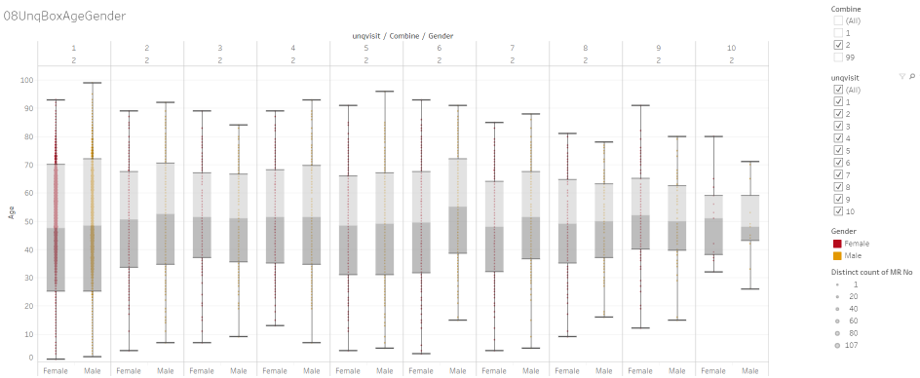
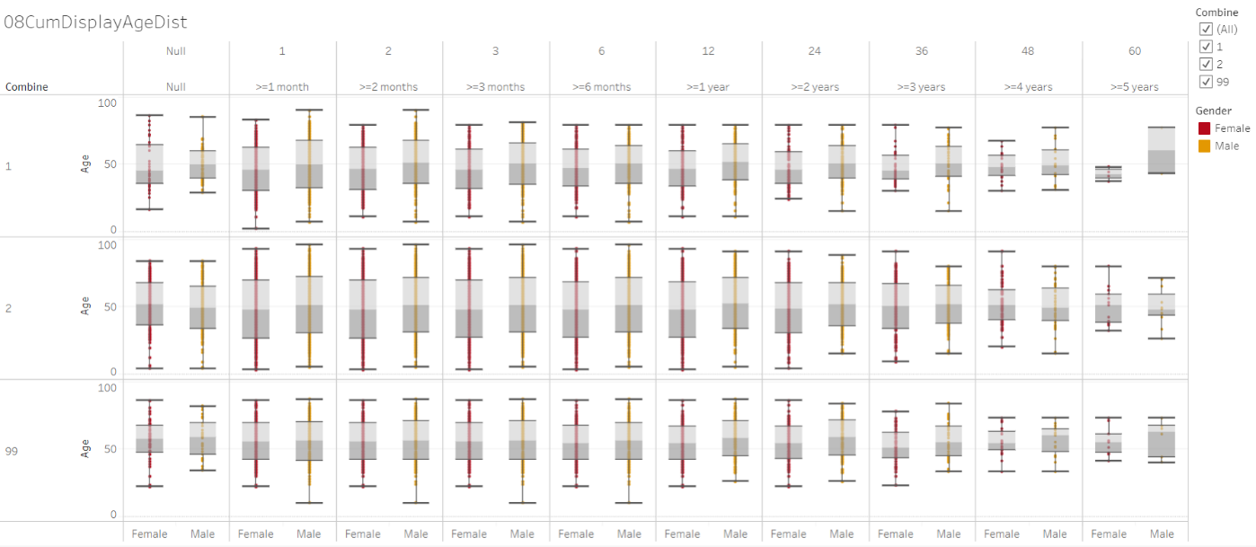
Hospital status: RMSD / Metabolic diseases
From start of the hospital to Oct 2016
01TotalPatRMSD_Metabolic
02AgeGroupByDisease
03AgeDistByDisease
08CumDisplayByDuration
08UniqueVisWindow
08UnqBoxAgeGender
08CumDisplayAgeDist
08CumDispByDurDisease
09CumDisByDurVitals
09CumStatsByDurVitals
09PatProfile
https://public.tableau.com/views/01RMSD_MET/01TotalPatRMSD_Metabolic?:display_count=y&:origin=viz_share_link

Slide 21
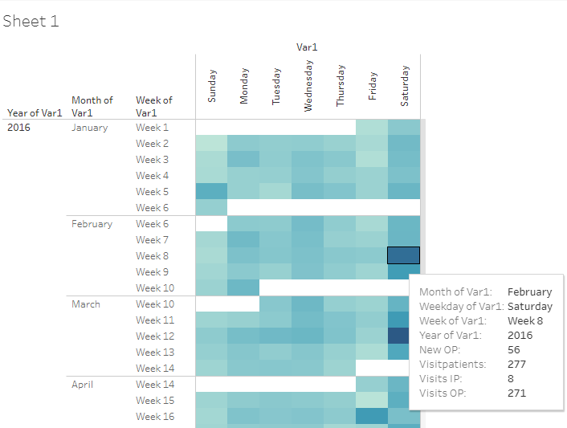
Operational view of number of patients
From start of the hospital to Oct 2016
Patients visiting on each day, details of visits displayed in the tooltip maximizing the usage of space
Supporting data to design availability of people on shifts on week days and week ends
https://public.tableau.com/views/04_calendar_view/Sheet1?:display_count=y&:origin=viz_share_link

Slide 22
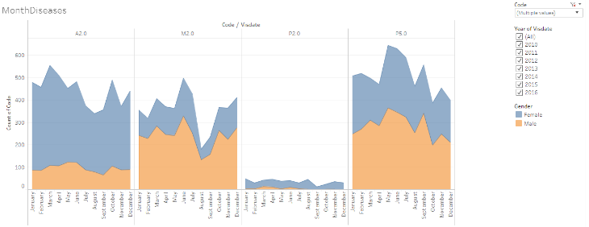
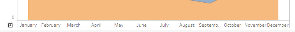
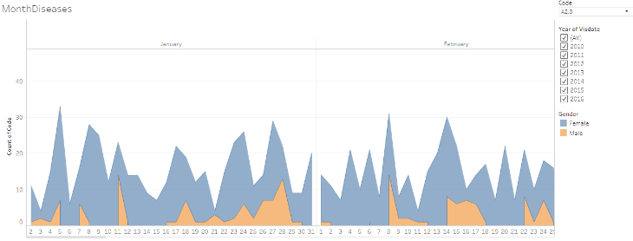
Frequency count of patients for each disease by month by gender
From start of the hospital to Oct 2016
This visual opens for each day, by clicking on “+” sign on the x-axis, showing the operational as well as scientific usefulness.
Seasonal variation,
Gender wise variation,
Disease variation
https://public.tableau.com/shared/GXXZXKK29?:display_count=y&:origin=viz_share_link

Slide 23
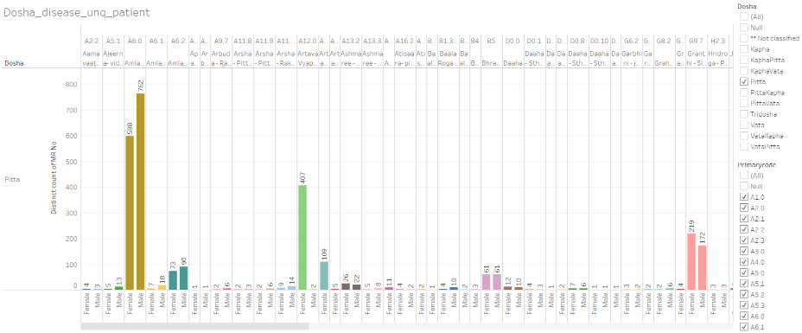
Dosha and disease
From start of the hospital to Oct 2016
https://public.tableau.com/views/Disease_by_dosha_type/Dosha_disease_unq_patient?:display_count=y&:origin=viz_share_link

Slide 24
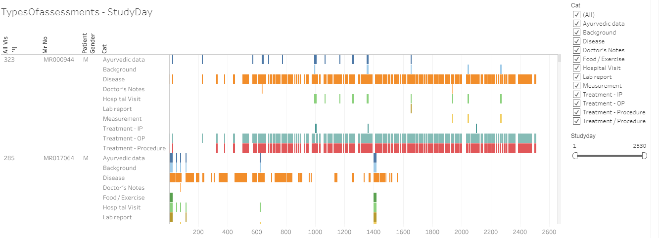
Types of assessment captured by CRFs for individual patients by visit day
From start of the hospital to Oct 2017
Data for individual patient displayed by visit day
Categorization
https://public.tableau.com/views/03_typesOfassessment/TypesOfassessments-StudyDay?:display_count=y&:origin=viz_share_link

Slide 25
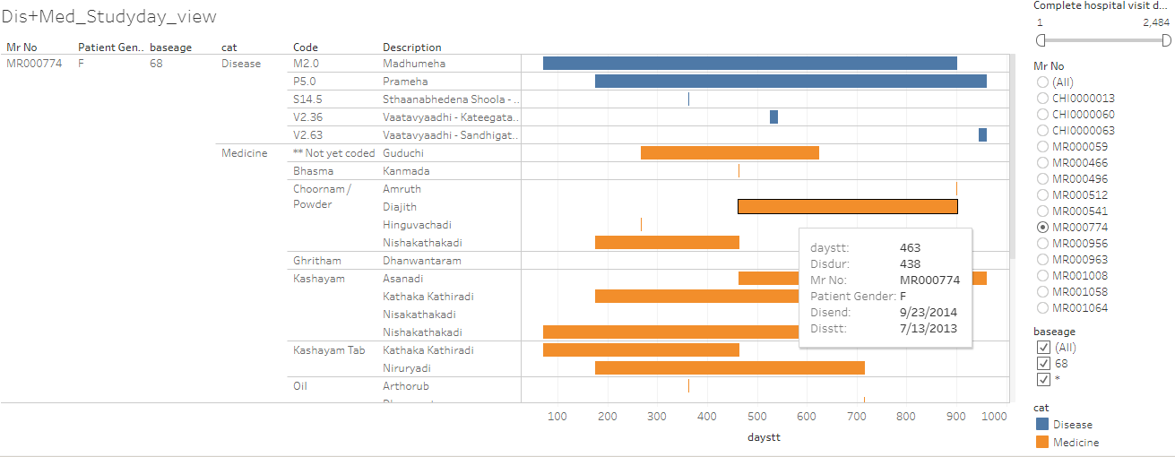
Patient profile view of individual patient by disease and medicine
From start of the hospital to Oct 2017
Example 9
Disease and medicine combined view
https://public.tableau.com/shared/HCSMCRXYP?:display_count=y&:origin=viz_share_link

Slide 26
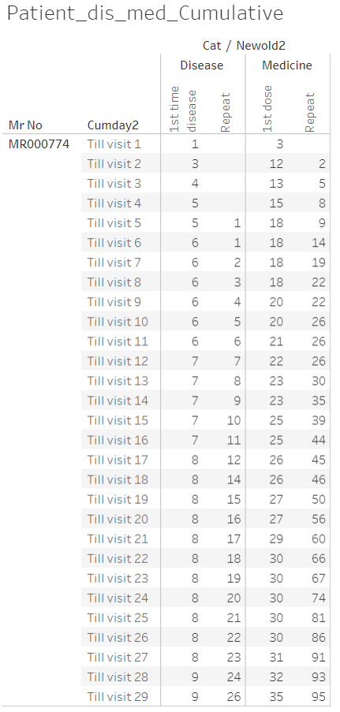
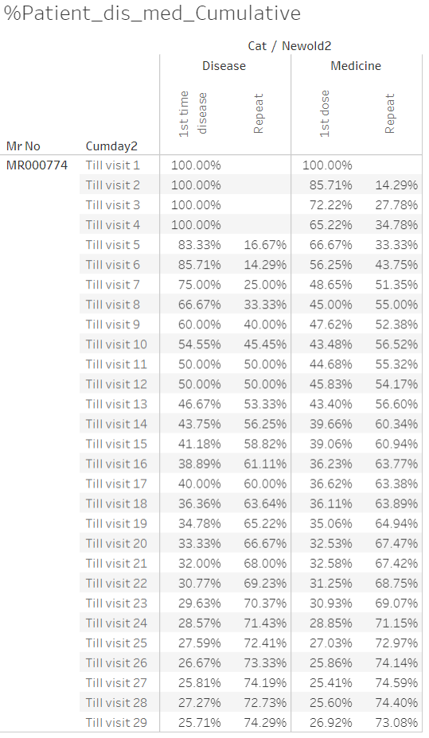
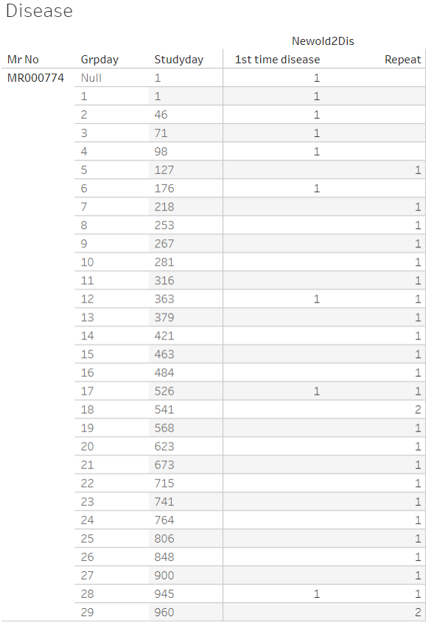
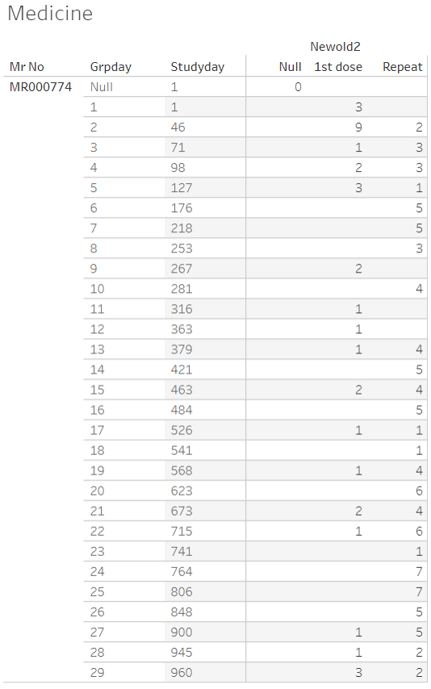
Number of reported diseases and prescribed medicines for each patient by visit
From start of the hospital to Oct 2017
https://public.tableau.com/views/080_medicine_dis_all_met_rmsd_prop/Dashboard1?:display_count=y&:origin=viz_share_link
https://public.tableau.com/views/080_medicine_dis_repeat_prop_cumulative/Dashboard1?:display_count=y&:origin=viz_share_link

Slide 27
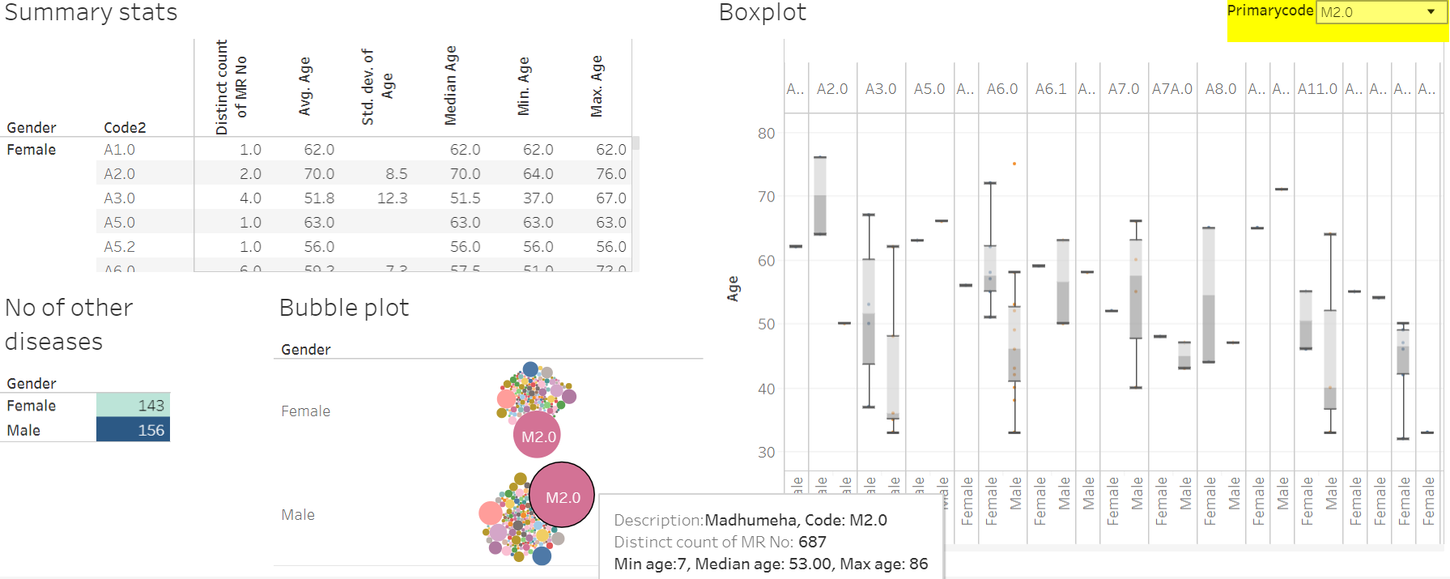
From start of the hospital to Oct 2016
Patients with Madhumeha and additional diseases reported
https://public.tableau.com/views/Primary_disease_and_all_other_diseases/Dashboard2?:display_count=y&:origin=viz_share_link

Slide 28
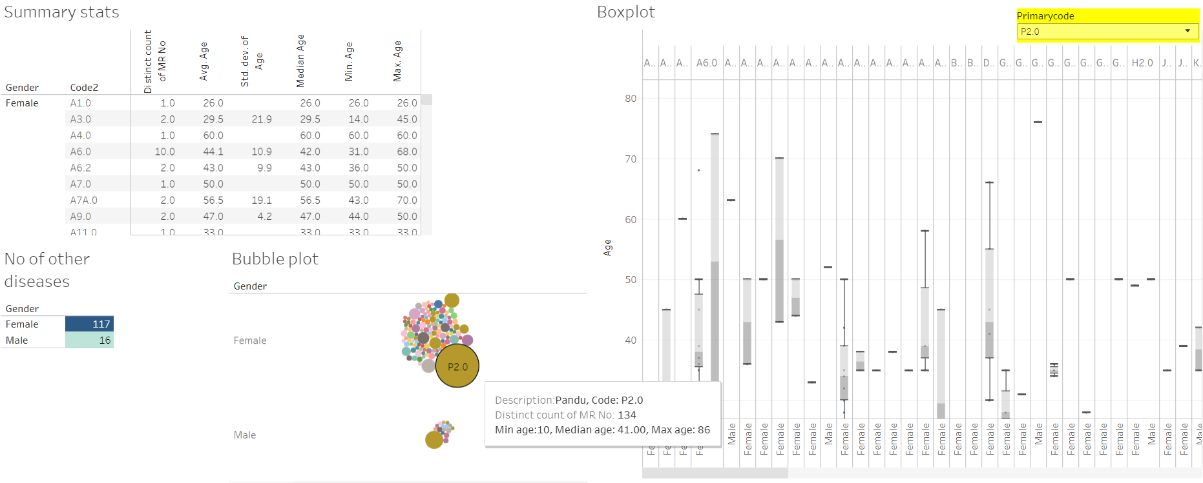
From start of the hospital to Oct 2016
Patients with Pandu and additional diseases reported
https://public.tableau.com/views/Primary_disease_and_all_other_diseases/Dashboard2?:display_count=y&:origin=viz_share_link

Slide 29
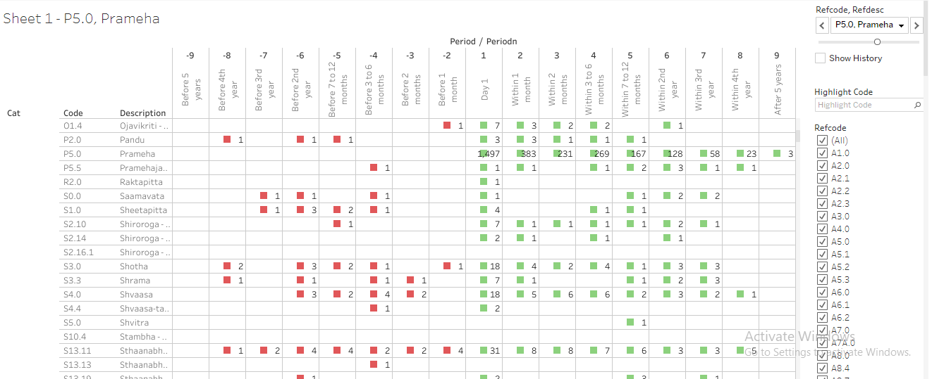
Pre and post co-morbidities for Prameha
From start of the hospital to Oct 2017
Prameha has been reported by 1497 patients. Out of these 383 patients visit hospital within 1st month, 231, 269, 167, 128, etc are in the following time points.
Other lines in the table provide details about diseases reported by these 1497 patients.
Bottom section of the table provides information about the treatment details for these patients.
https://public.tableau.com/views/085_dis_1st_time_refCal_NodesEdges/Sheet1?:display_count=y&:origin=viz_share_link

Slide 30
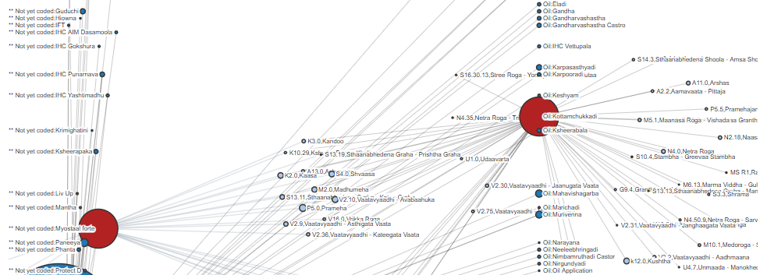
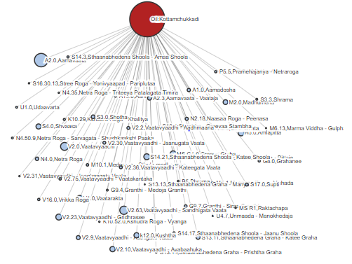
Relationship between diseases and medicines
From start of the hospital to Oct 2017
Amavaata [https://coursephd.github.io/nodediagram/A2_0/] Amavaata by period [https://coursephd.github.io/nodediagram/A2_0byperiod/]
Prameha [https://coursephd.github.io/nodediagram/P5_0_Prameha/] Prameha by period [https://coursephd.github.io/nodediagram/P5_0_Pramehabyperiod/]

Slide 31
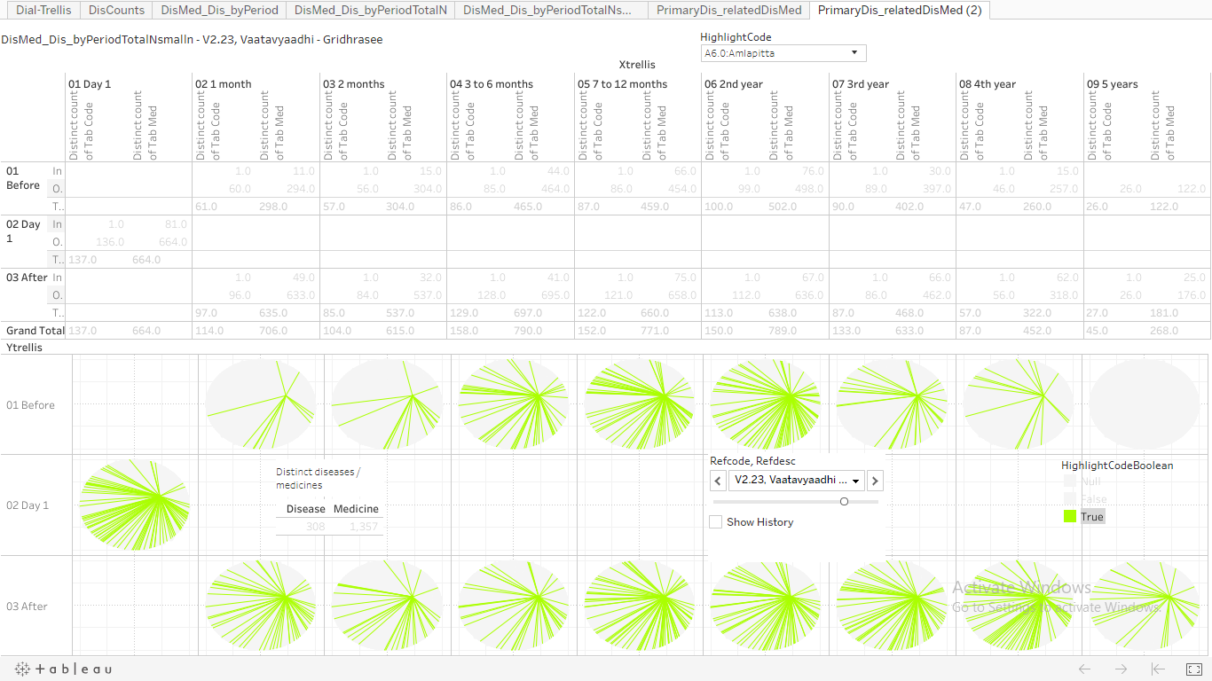
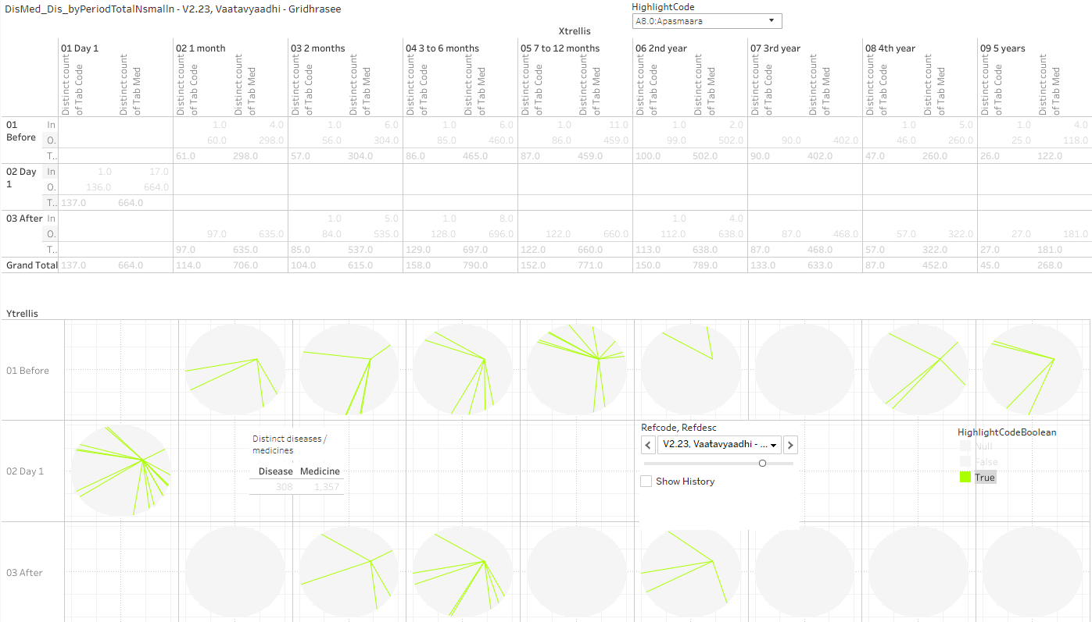
Circular view representation of disease and medicine co-occurrences, pre and post
From start of the hospital to Oct 2017
Interpretation, Many green lines means:
There is a greater chance of diseases reported by patients
There is a greater chance of a medicine prescribed for a disease
Visualization of
Co-occurrences of disease and medicine
Co-occurrences of disease and disease
https://public.tableau.com/views/085_dis_count_edges_3rd_byPeriod02try/PrimaryDis_relatedDisMed2?:display_count=y&:origin=viz_share_link

Slide 32
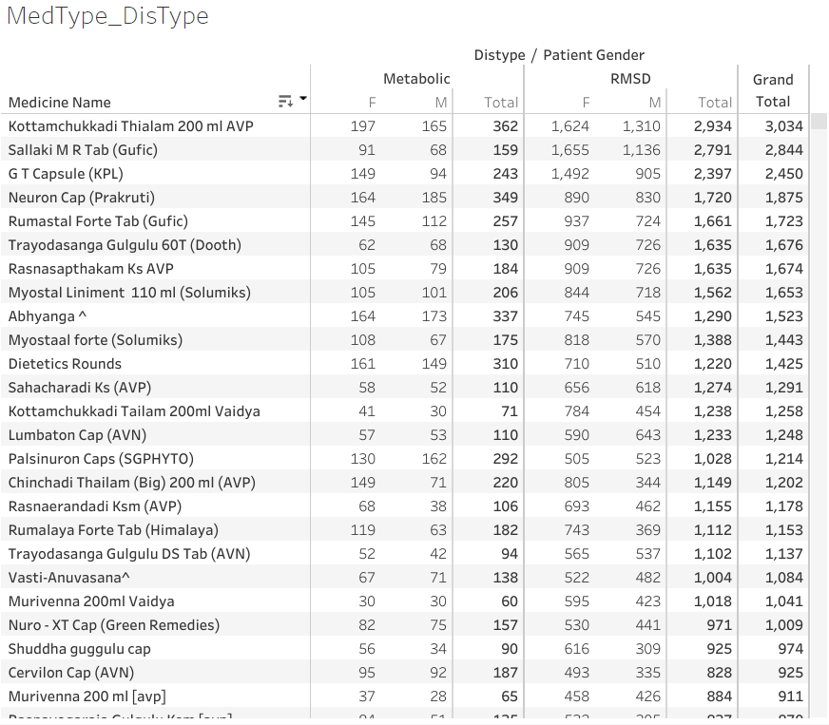
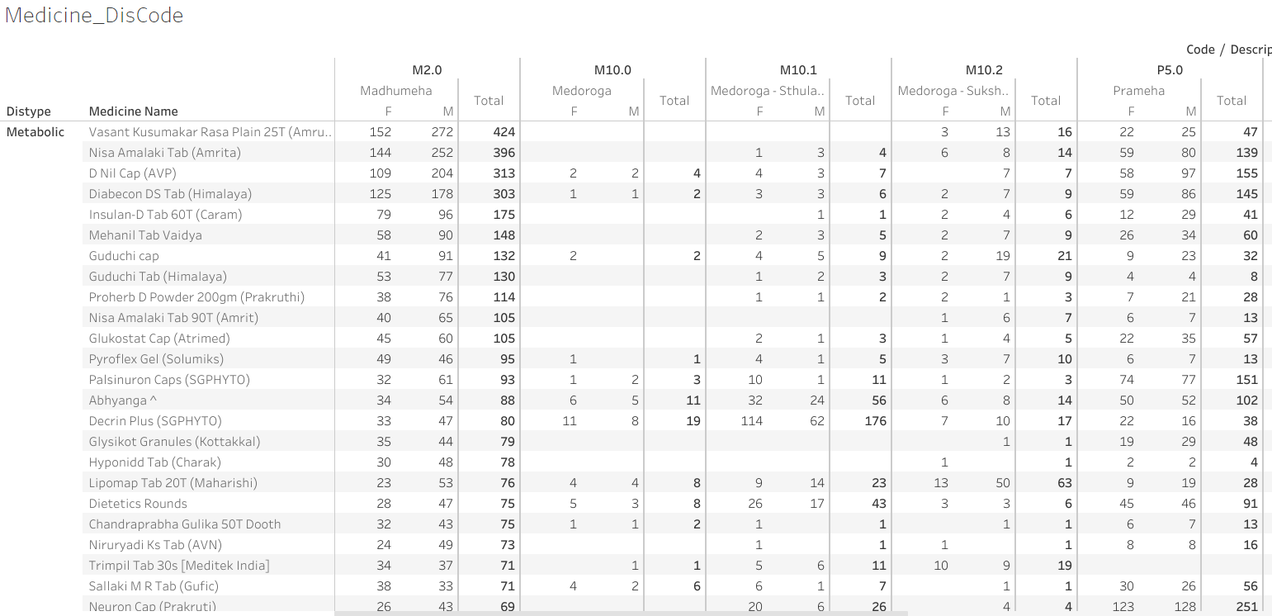
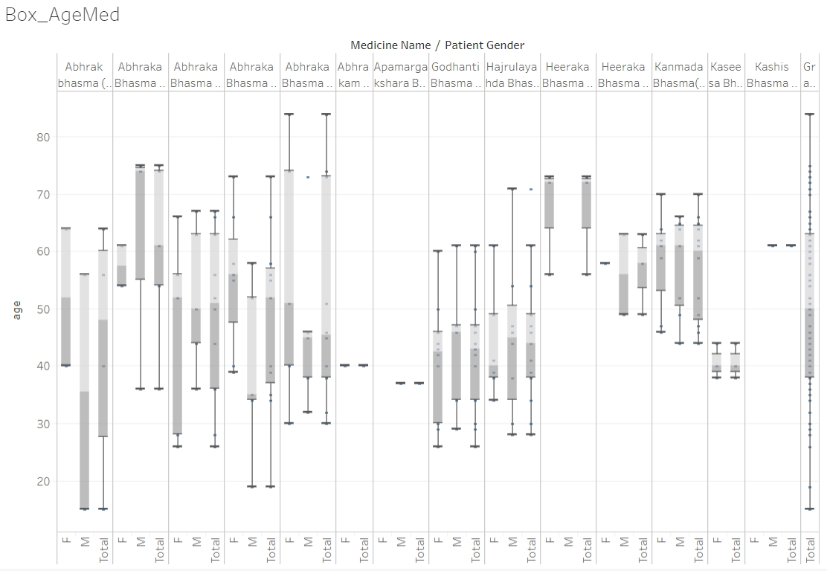
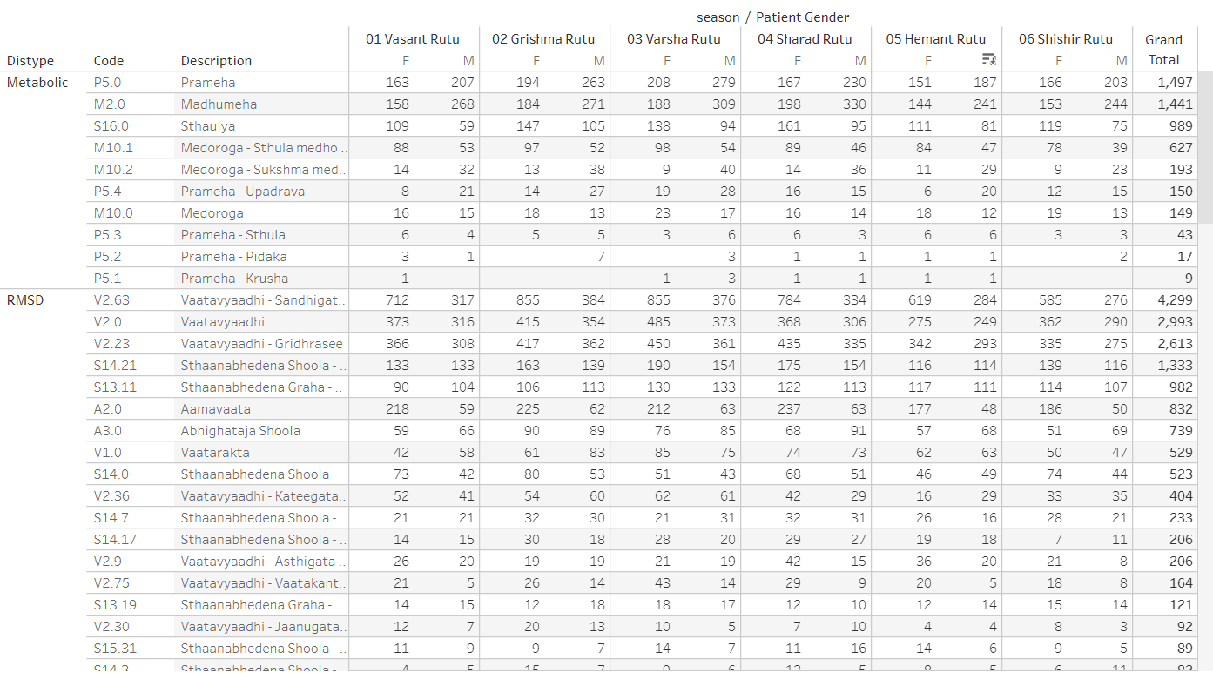
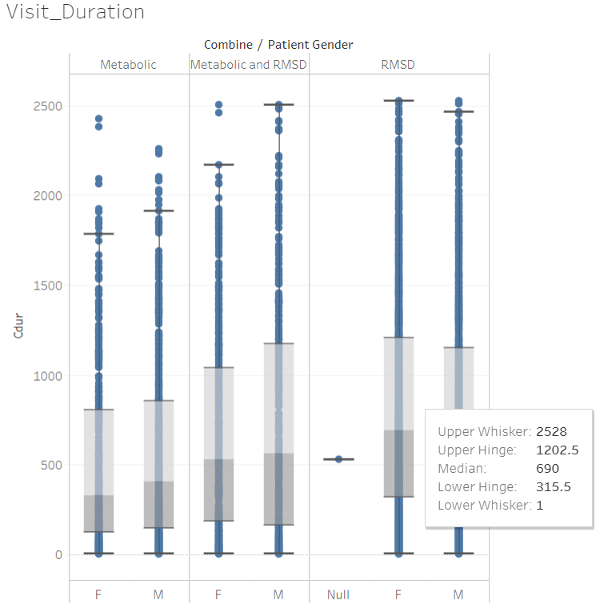
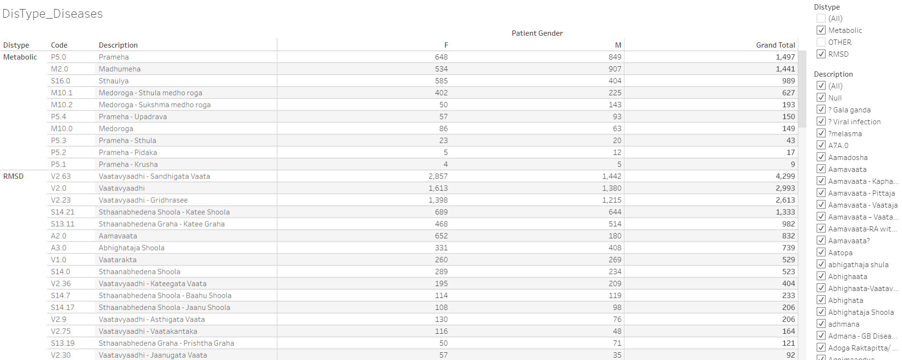
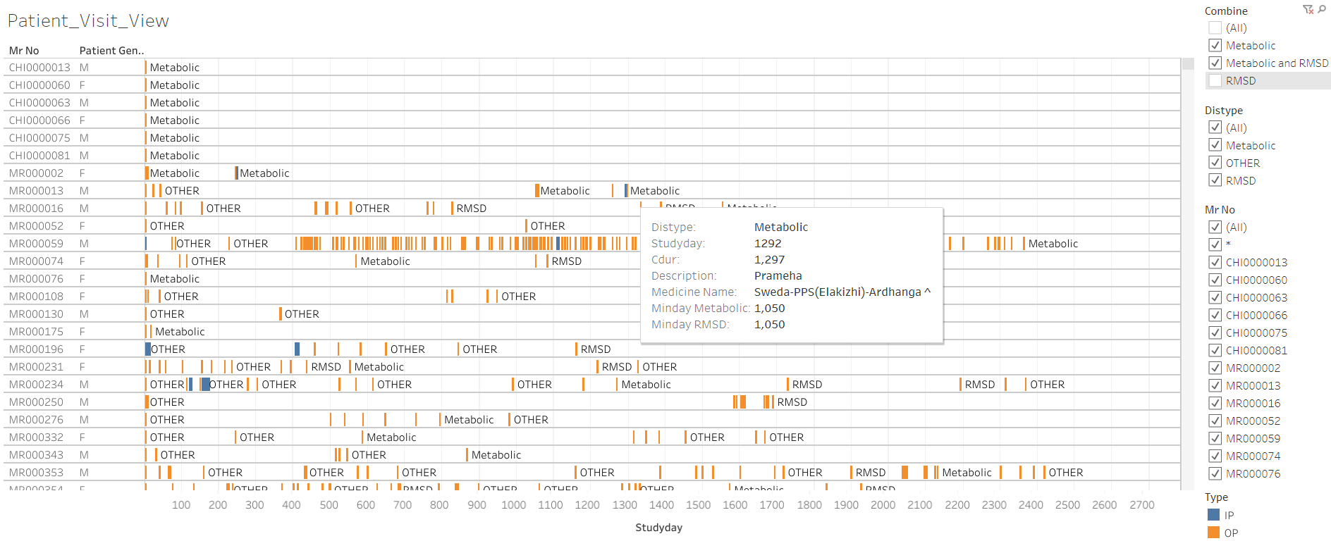
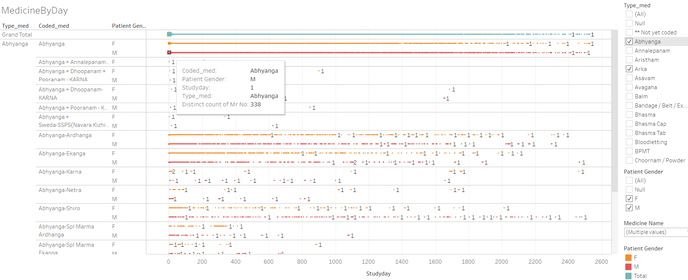
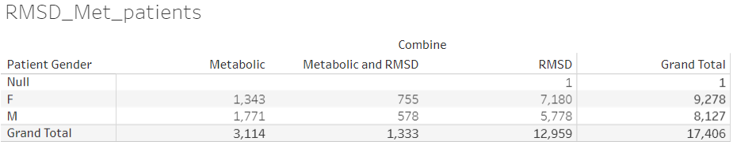
RMSD and Metabolic disease group analysis
From start of the hospital to Oct 2017
RMSD_Met_patients
Visit_Duration
Patient_Visit_View
1stDay_Met_Disease
DisType_Diseases
MedType_DisType
Medicine_DisCode
DiseaseByStudyDay
DiseaseByStudyDaySeason - 01 Vasant Rutu
MedByStudyDay
SeasonDisease
SeasonMedicine
PatProf_season - Aamavaata
Box_AgeMed
Slopegraph_disPatients
Slopegraph_disVisit
MedicineByDay
https://public.tableau.com/views/01SQL_Dis_Med_Ser/MedicineByDay?:display_count=y&:origin=viz_share_link

Slide 33

RMSD and Metabolic disease group analysis
Pre and Post analysis for disease
From start of the hospital to Oct 2017
https://public.tableau.com/views/DistanceMeasuresTimePeriod-086prgm/DiseaseMaxDist?:display_count=y&:origin=viz_share_link

Slide 34

RMSD and Metabolic disease group analysis
Pre and Post analysis for medicine
From start of the hospital to Oct 2017
https://public.tableau.com/views/DistanceMeasures-Medicines/MedicineMaxDist?:display_count=y&:origin=viz_share_link

Slide 35

Radar plot: visualize many parameters of a disease to see similarity / dis-similarity
From start of the hospital to Oct 2017
https://public.tableau.com/views/300_radar_plot/Radar-Plot-trellis?:display_count=y&:origin=viz_share_link

Slide 36

Disease and treatment relation
From start of the hospital to Oct 2017
https://public.tableau.com/views/305_medicine_dur_by_dis/TreeMapDisMed-Parameter?:display_count=y&:origin=viz_share_link

Slide 37
Similar cases studies
From start of the hospital to Oct 2017
Vrikka roga
Group of cancers

Slide 38




Comorbidity analysis
From start of the hospital to Oct 2017
Clinical and epidemiological studies indicate that disease comorbidities have a great impact
on the evolution of health status,
selection of appropriate treatments and
health system costs
Comorbidity analysis can be carried out based on EHR data:
Patient Data
Diagnosis Data
Admission Data
Index Disease Data
Reference to the R package: comoRbidity

Slide 39






Comorbidity analysis
From start of the hospital to Oct 2017
Reference to the R package: comoRbidity

Slide 40
Parkinson Disease data analysis – case series
From start of the hospital to June 2017
Section 1:
A "case series" in real clinical practice, IAIM hospital from 2011 to 2017.
The hospital database covers more than 300 patients deemed to be PD patients.
Some of them inaccurately classified as "kampa vata" patients.
Clinical challenge could be explained while diagnosing the patients correctly (some frequency counts already shown for V2.34.0).
Need to explain about the Not PD, PD and PD+ categories.
Section 2:
Table "Number of patients with diagnosis type and gender" -- provides insights on male, female distribution.
Males are almost 2 times of females. If this is the natural course of disease, it adds one more point to the overall discussion -- alternative medicine and western medicine practitioners get similarly distributed patients. Subsequent table describes the age group summary stats and same is displayed in the box plot.
Section 3:
Description about the duration of illness: Patients in PD and PD+ categories have similar mean and median years of illness.
Duration of follow-up for PD patients is more than for PD+ patients
Female PD patients are coming for longer median duration than the male patients
Duration is depicted in terms of number of visits as well.

Slide 41
Parkinson Disease data analysis – case series
From start of the hospital to June 2017
Section 4:
Analysis on 18 patients who are categorized into PD and PD+ having UPDRS score. We will need to explain why only for 18 patients UPDRS score captured, in order avoid any questions on any kind of bias.
Section 5:
For various parameters baseline, final value, and change from baseline are calculated.
Page 8 onwards the document: Baseline values for PD patients are lower than that for PD+ patients (~15 vs. ~40), in both the groups, some reduction is shown in the final value.
Change from baseline < 0 is improvement, > 0 is deterioration, = 0 is no change.
-- UPDRS shows some reduction
-- Tremors / functional score do not reduce for PD patients, but for PD+ patient they reduce.
-- Rigidity reduces for PD patients, and remain almost similar for PD+ patients.
Section 6:
Page 13: status of medications and corresponding scores out these 18 patients. 5 patients who are drug naive should be explained as Patients directly opting for Ayurvedic treatment. 2 patients for whom drug was reduced need to be explained as special cases. Is it possible to explain for how long the drug was redcued.
Section 7:
If we have multiple post baseline values for all the UPDRS, tremors, functional scores, etc. then we could additionally plot them.

Slide 42
Top 15 diseases treated
From start of the hospital to Oct 2016
Most of the traditional diseases appear on the list of most frequent diseases
Disease | Grand Total | Female | Male
Vatavyadhi – Sandhigata vaata | 3577 | 2339 | 1238
Vatavyadhi | 2783 | 1507 | 1276
Vatavyadhi – Gridhrasee | 2034 | 1055 | 979
Vatavyadhi – Avabaahuka | 1482 | 865 | 617
Amlapitta | 1429 | 628 | 801
Prameha | 1375 | 585 | 790
Shvaasa | 1228 | 543 | 685
Netra Roga | 1120 | 516 | 604
Madhumeha | 1063 | 369 | 694
Staanabhedana Shoola – Katee Shoola | 978 | 494 | 484
Sthaulya | 831 | 487 | 344
Greeva Graha | 821 | 399 | 422
Kaasa | 814 | 410 | 404
Staanabhedana Graha – Katee Graha | 796 | 363 | 433
Kshudra Roga | 725 | 378 | 347

Slide 43



Wod2vec analysis
From start of the hospital to Oct 2017
Top 10 closest and Top 10 farthest
To make the visualizations more relevant
relationships between a query disease (in red),
its 10 most similar diseases in the model (in blue), and
10 farthest diseases from the vocabulary (in green).
Google Colab python program: https://colab.research.google.com/drive/1pJv39GrrFjadaoI4m9QuPw4W4-i2s9lh?usp=sharing

Slide 44

FastText analysis
From start of the hospital to Oct 2017
The text was created as a textual representation
of diseases and treatments, age groups and gender
Google Colab python program: https://colab.research.google.com/drive/1rZy-nNC3E5sK7K6V9mbs9qD6-SptJnPT?usp=sharing

Slide 45
Analysis: word2vec, fasttext, MCE or wang2vec algorithms.
From start of the hospital to Oct 2017
Attaching a link to the visuals created based on
TensorFlow link:
https://projector.tensorflow.org/?config=https://raw.githubusercontent.com/coursephd/PostgreSQL/master/DeepLearning/002-dismed-subgrp-w2v/099-multiple-config.json

Slide 46
How does it help?
Credible basis for medical decisions
Cause, diagnosis, prognosis, relationship
Trends
New
Hypotheses,
Questions / answers
Treatments, diseases
Validation of anecdotes, assumptions, beliefs

Slide 47
Documents to Data: Ayurveda Practice Need
GIGO!
Precision in documentation
Patient data
Demography, socio-economics, clinical history…
Diagnosis data
Risk, causation, symptoms, lab data, diagnosis…
Interventions
Drug, diet, lifestyle (exercise, meditation..), advice, …
Outcomes
Clinicians assessment, Patient reported outcomes, lab…

Slide 48
Creation of reference data – part 8 source data
The above 17 steps have allowed us to go
from raw data (electronic medical record) to the following combined datasets
Dataset name | Saved as | Information
temp30_5 | pat_diag_vis.csv | mr_no [Unique Patient ID] patient_id [Visit ID] patient_gender [Gender] city_name [City] state_name [State] dateofbirth [DOB] country_name [Country] | death_date [Date of death] consult_id [Consultation ID] description [Disease description] icd_code [ACD code] diag_type [Primary / secondary] Diagdate [Diagnosis date] patient_presc_id [Medicine / Service ID]
base01_ip | base01_ip.csv | 14 variables + In Patient prescribed medicines
base01_op | base01_op.csv | 14 variables + Out Patient prescribed medicines
base01_ser | base01_ser.csv | 14 variables + Services prescribed
services | services.csv | Master list of services for decoding services ID
med | med.csv | Master list of medicines for decoding medicines ID

Slide 49
Source data – discussion
These tables exist in the hospital database since 2011
These have not been utilized as the outlined here
Challenges:
Insufficient documentation of how the database was built
Patient ID not available across tables
Many tables (150 to 800)
Same information captured in many places

Slide 50
Thank you

